Slide 1
On-Premises Deployment
Mojaloop PI20 – 1:30pm EAT
Addressing the challenges
Mojaloop PI-20 event, October 2022 - David Fry

Slide 2



Who are we?
Miguel
Mojaloop Principal Architect,
Infitx
David Fry
Director - Cloud Infra,
Infitx
Steve Bristow
Hybrid-Cloud infrastructure specialist

Slide 3
On-Premises Deployment
Majority of Mojaloop deployments have been cloud based
Many Mojaloop customers favour on-premises deployment
Rapidly Scalable
Low ‘door price’ – cost-of-entry
Implicit Security
Transparency – no hidden cloud-limits
Visibility – the ability to measure every single facet of a system
Resolute control – ownership of problems and security from bottom-to-top
Compliance – Clear Data Sovereignty, Legal boundaries and responsibilities.
Latency – workloads can be located as close to consumers as possible
Mojaloop should be available to everyone – but is currently excluded where compliance demands data is stored in-country, and cloud providers do not have presence.
Sizing a larger mojaloop deployment is not a turnkey process – and mistakes are expensive!
mojaloop-IaC facilitates a rapid, repeatable, standardised deployment on-prem and in-cloud.

Slide 4
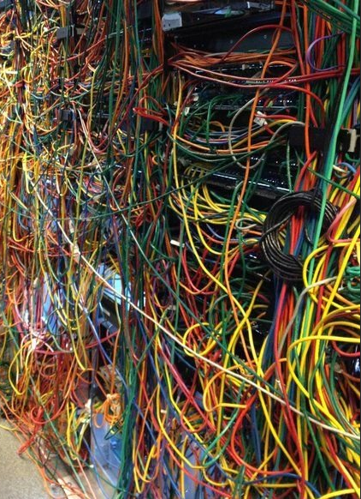
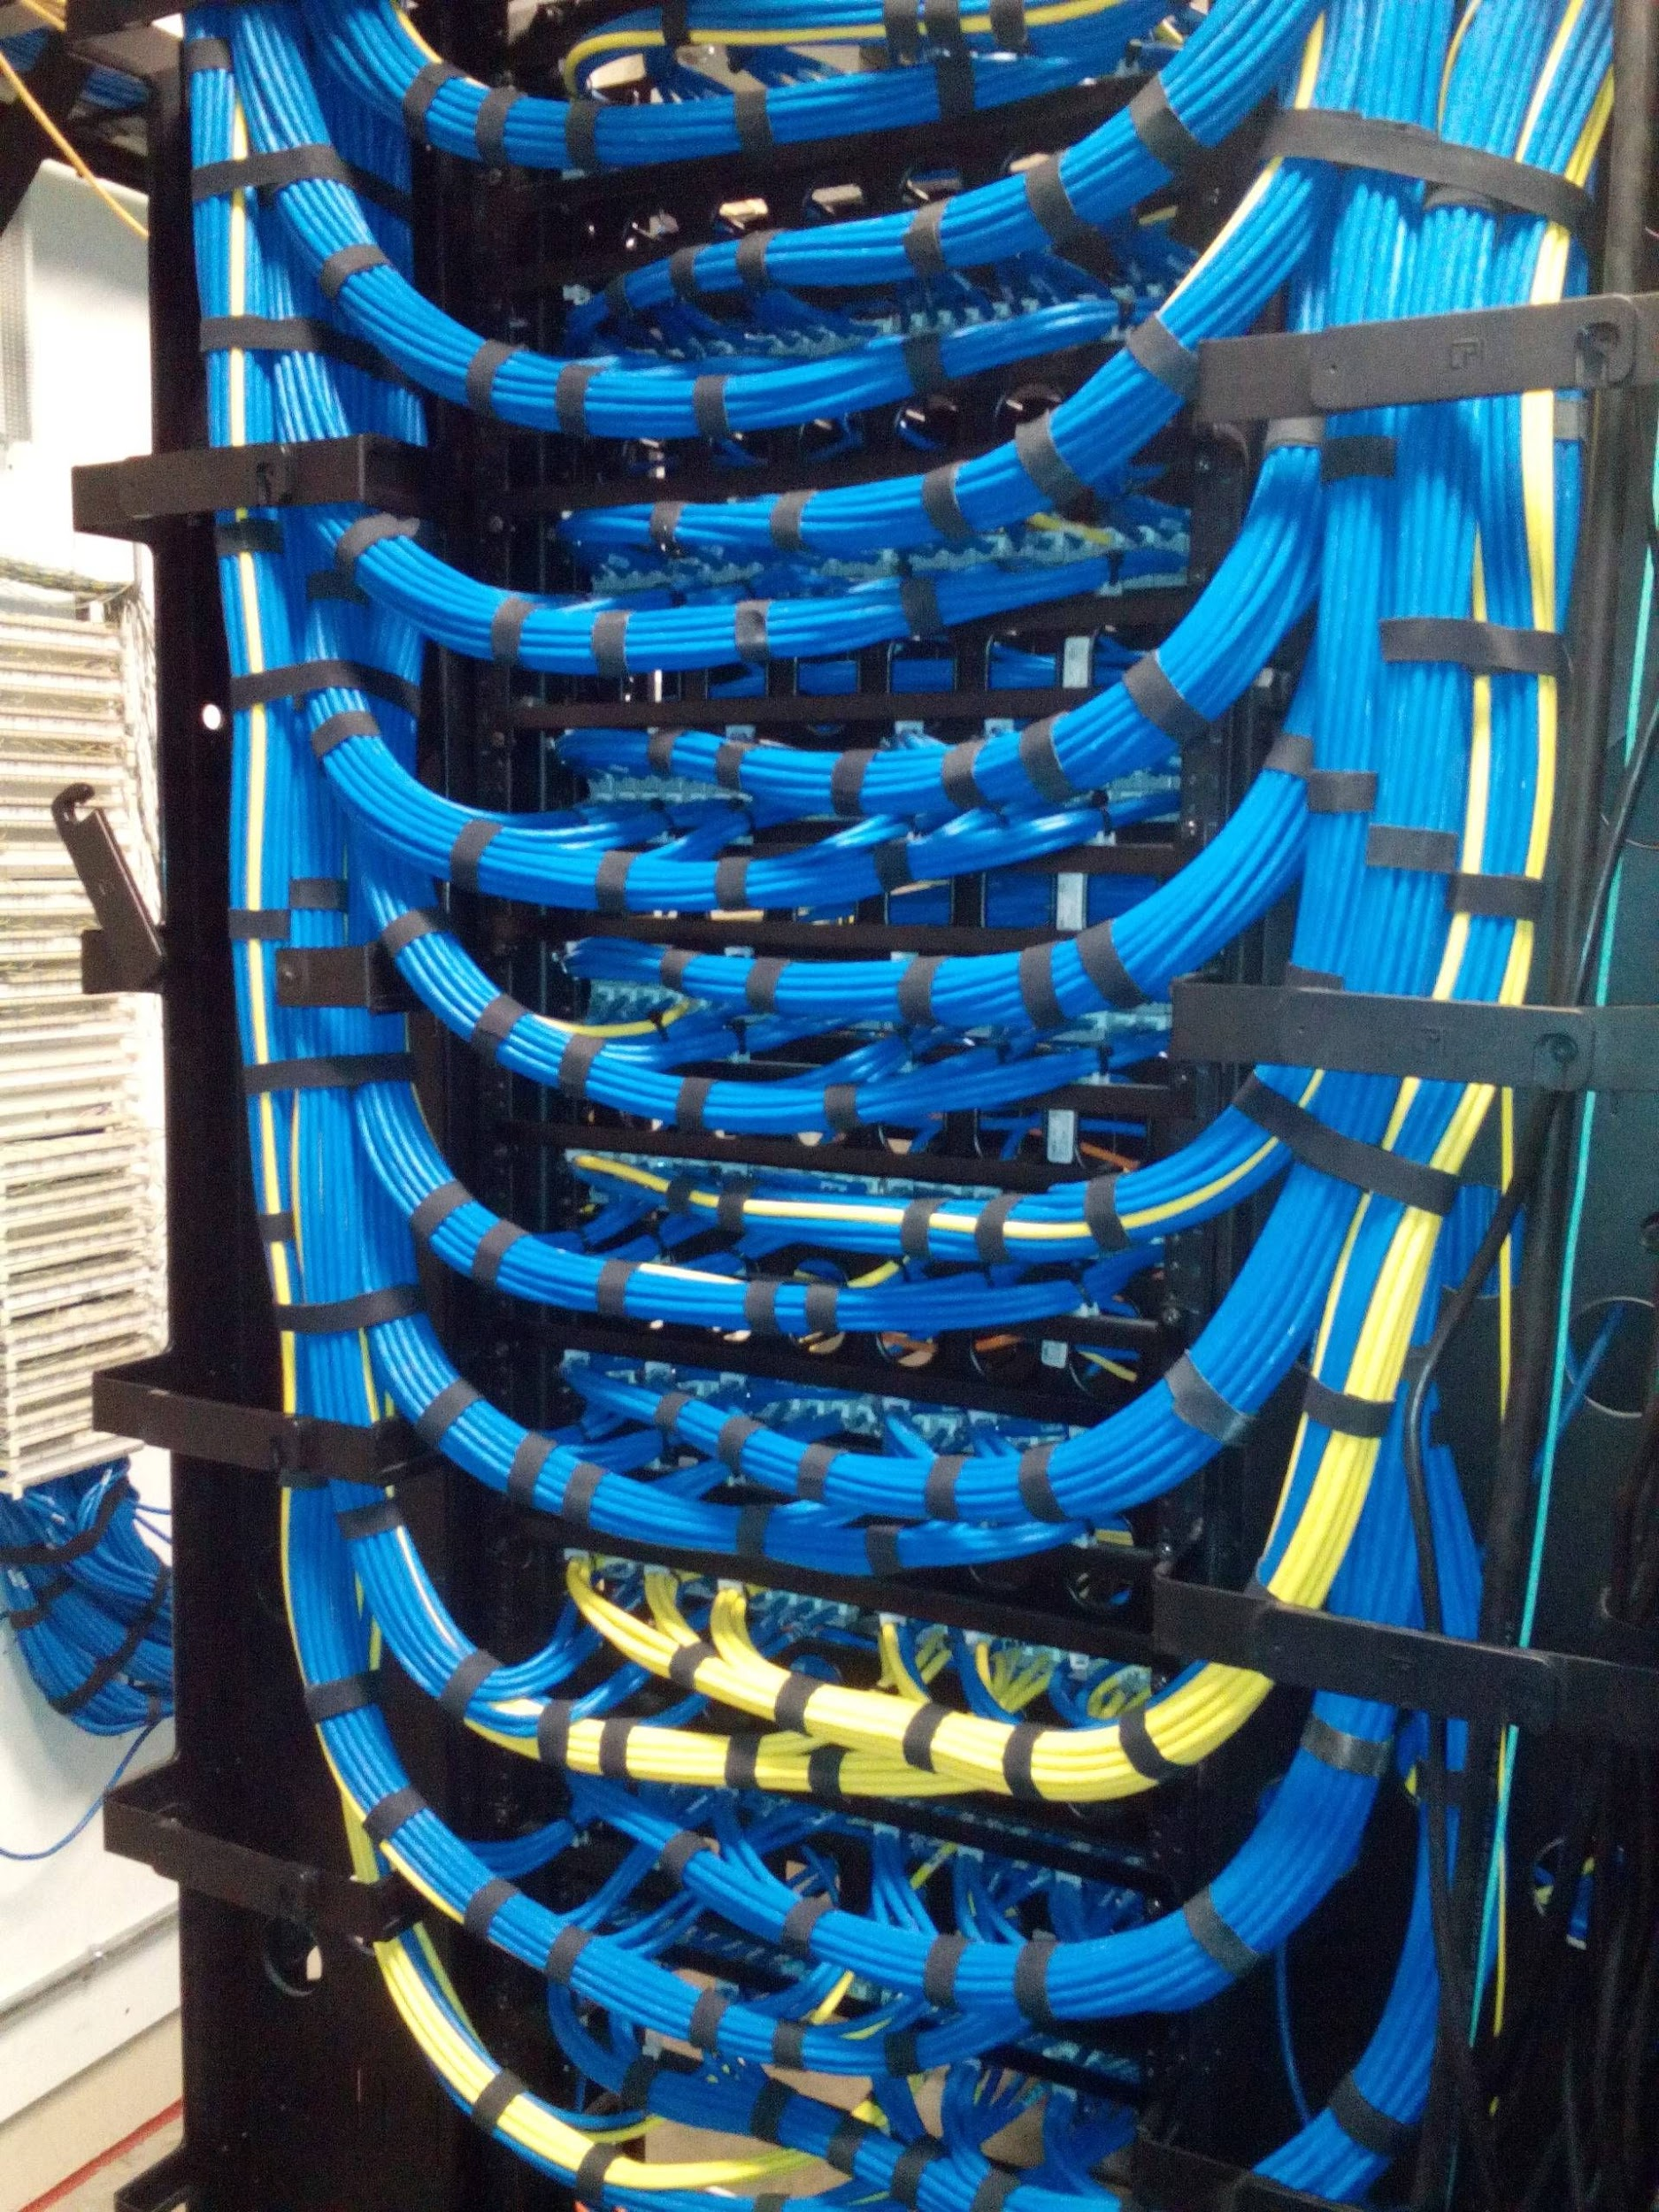
The on-prem challenge
Appropriate Datacenter(s)
Cooling, Cabling, Power, Security
Adequate connectivity
Internet Adjacent, Diverse routing, Low Latency
Managing Availability
Maintenance windows, multiple sites, unplanned outages
Scaling
Support contracts, Finding hardware, purchase cost
Scaling!
Quantities, Shipping, BoM
Scaling!!
Predict Growth, Business Case, RoI

Slide 5
Availability
Understanding the cost implications of an availability model

Slide 6
Understanding Availability
 | Description | Public Perception | Regulator Perception
1 minutes | Absorbed by DFSP queues. | Unnoticed. | Unnoticed.
5 minutes | Timeout and Retry thresholds reached. | Transactions aborted. Customers Retry. | Unconcerned.
10 minutes | Customer Retries fail. | System is perceived as “Down”. | Interested.
20 minutes | Repeated retries fail. | Reputational Damage. | Report expected.
1+ hours | Outrage cycle begins. | Severe Reputational Damage. | Audit likely.
Availability is an expensive.
Risk appetite should be decided, documented and agreed and communicated before Go-Live.
Solution design should always consider risk-appetite.

Slide 7
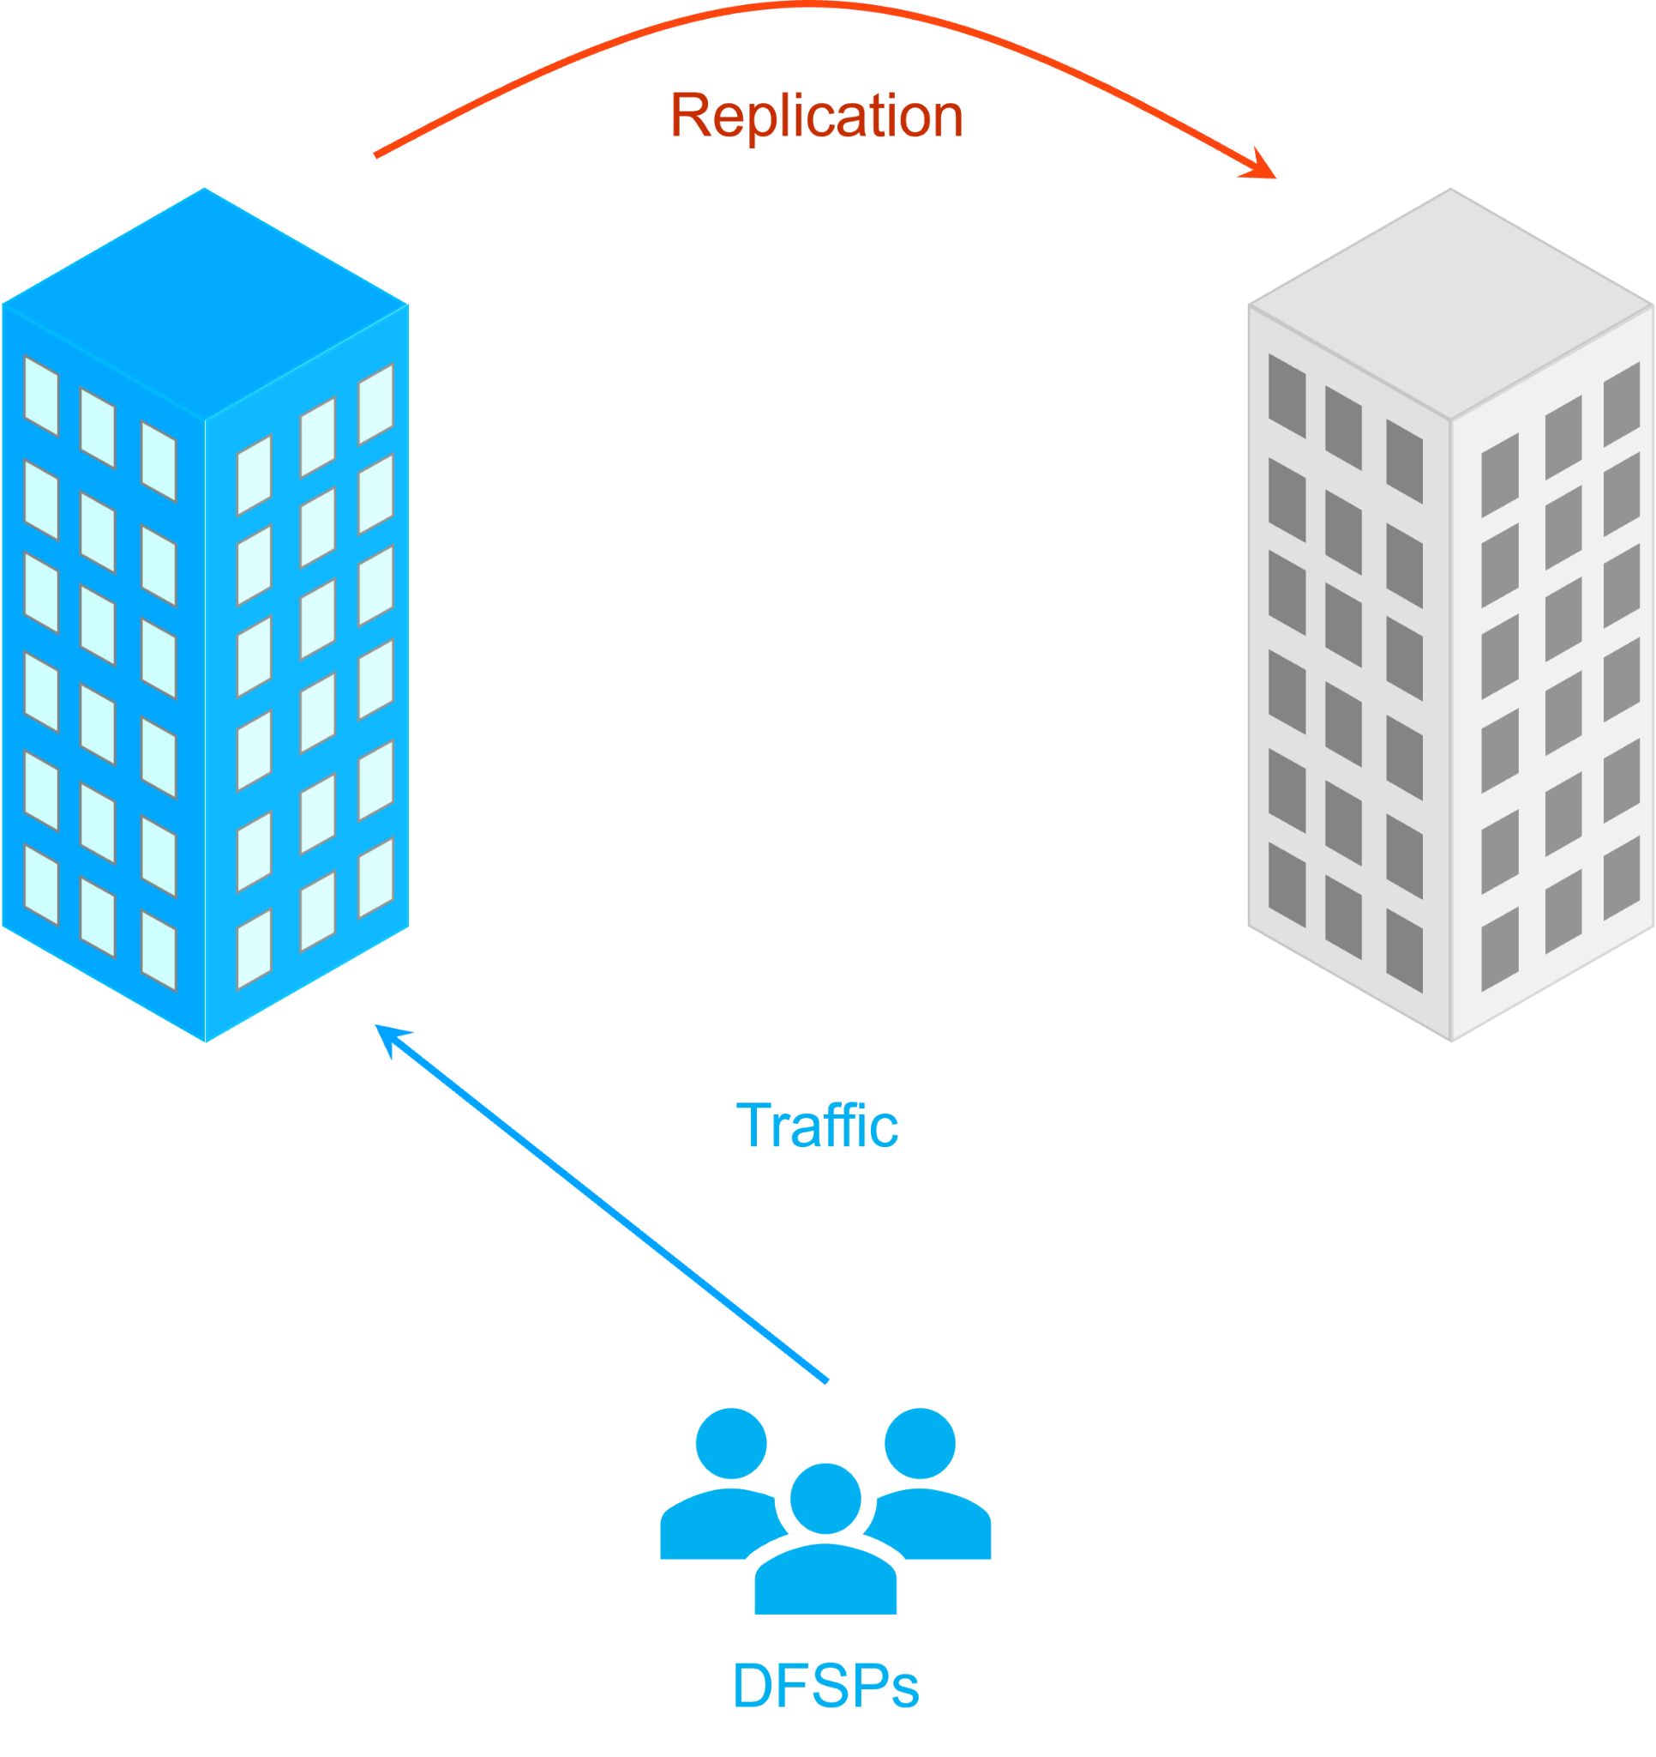
Understanding Availability
Is N+1 enough: Active + Passive
Under Normal Operation
Every transaction must wait for replication (failures on ‘passive’ side may still impact ‘active’ side).
Maintenance requires pausing replication.
50% of infrastructure is available, but not processing live transactions.
Failover must be tested often.
During a controlled failover
Interruption to accepting new transactions.
In-Flight transactions will finish.
Must be performed during periods of low-throughput.
During an uncontrolled failover
Complete outage during uncontrolled failover process.
Most In-Flight transactions will be lost.
Likely to require Manual Failover (See ‘Active-Active Split-Brain’).

Slide 8
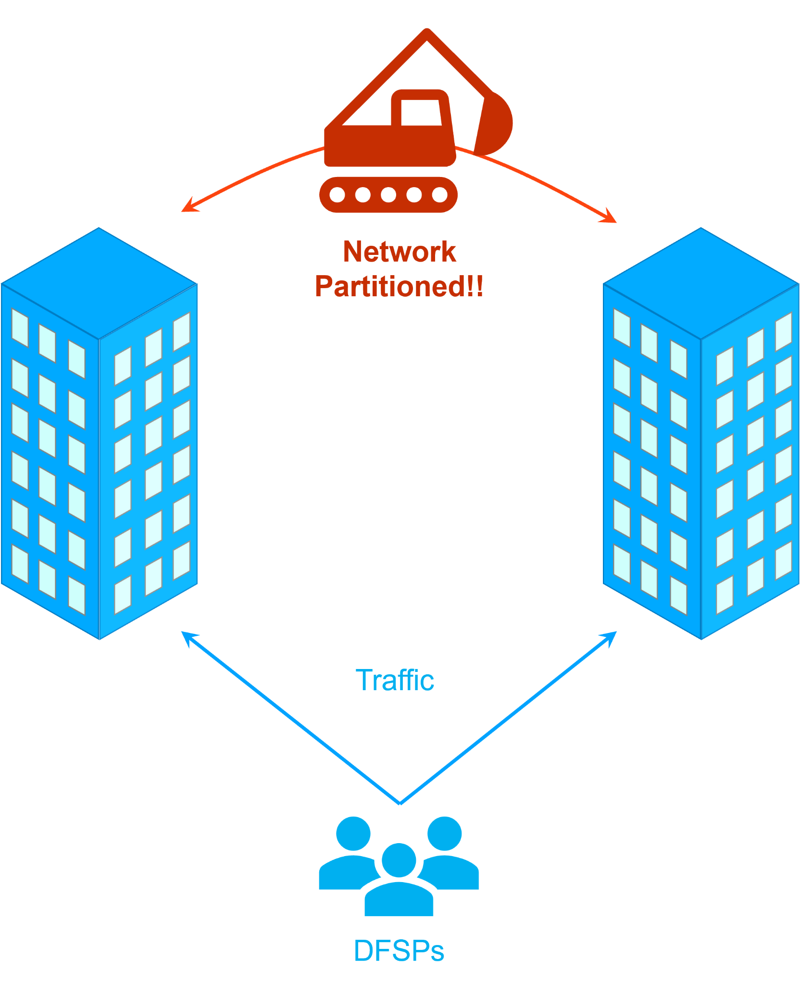
Understanding Availability
Not Recommended
Is N+1 enough: Active + Active
Under Normal Operation
Every transaction must wait for replication (issues in one DC may still affect the other).
Maintenance requires pausing replication and incoming traffic to target DC.
50% of each DC must be reserved for peak transaction flow.
Failover must be tested often.
During a controlled failover
No interruption to transaction traffic – DC ‘drains’ inbound connections.
In-Flight transactions will finish.
Best performed during periods of low-throughput.
During an uncontrolled failover
In-Flight transactions to failed DC will be lost.
In-Flight transactions to healthy DC will pause.
Likely to require Manual Failover.
Significant Risk of ‘Active-Active Split-Brain’.
During a Network Partition:
Both sites believe the other has failed.
Both sites will assume they own the master data set.
Both sites will continue to transact using independent copies of the database.
This Scenario is generally catastrophic. Recovery requires the chronological replay of all transactions that took place since the partition in order to arrive at a fully coherent database. The system is usually unavailable whilst this “brain-merge” takes place.

Slide 9
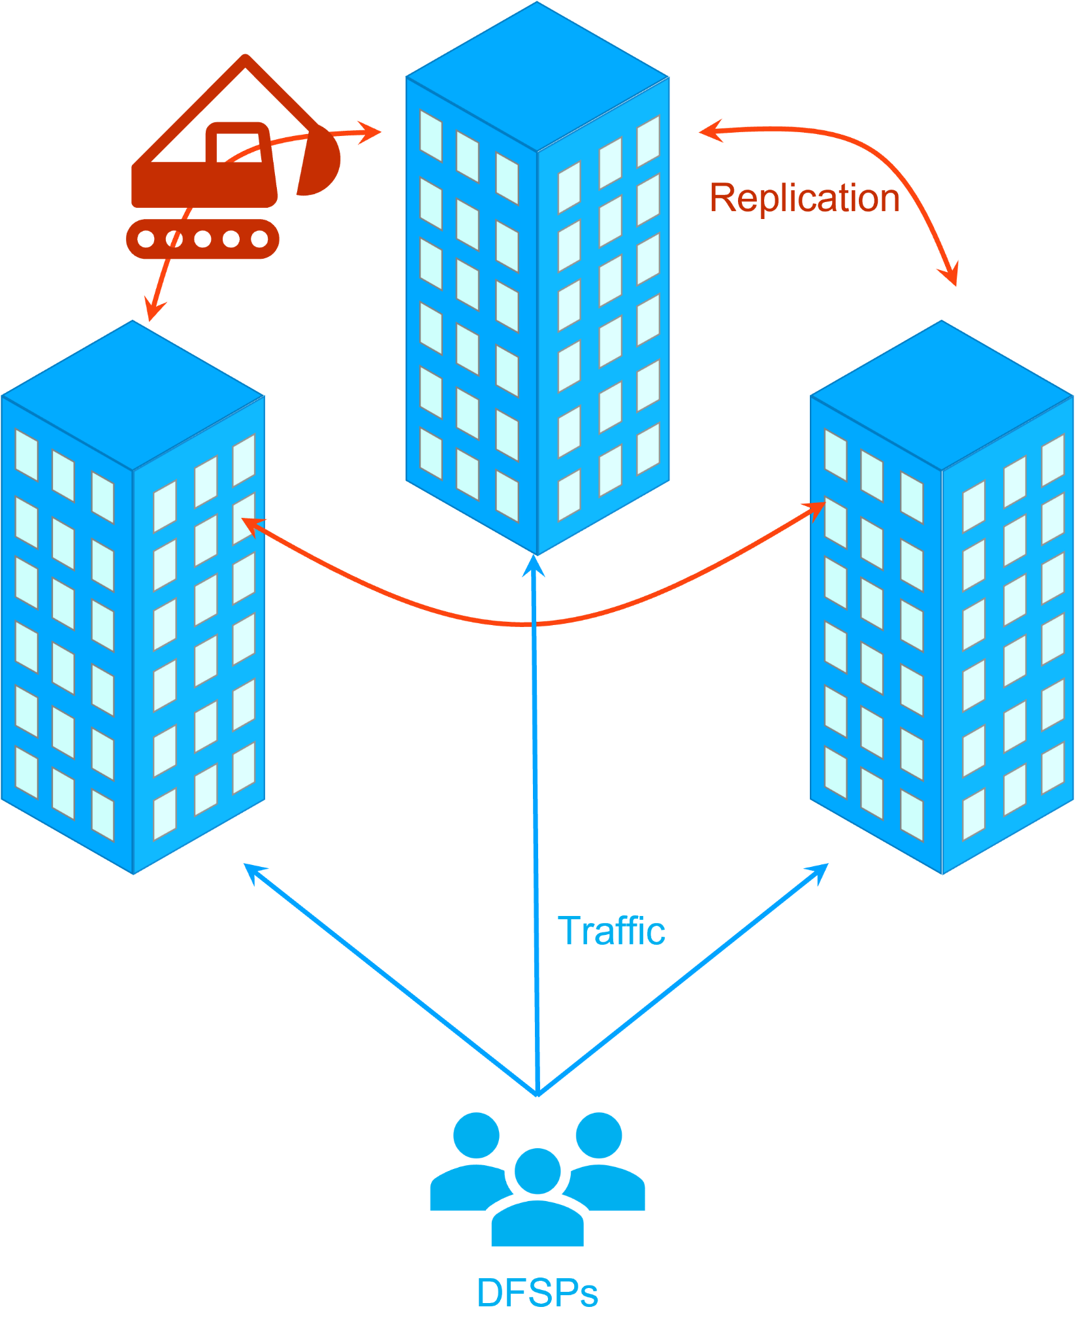
Understanding Availability
Is N+1 enough: Active + Active + Active?
Under Normal Operation
Every transaction must wait for replication to at least one DC.
A single DC can be ‘drained’ for maintenance, leaving an active+active configuration.
Only 30% of each DC must be reserved for peak transaction flow.
Failover testing still leaves two operational DCs.
During a controlled failover
No interruption to transaction traffic – DC ‘drains’ inbound connections.
In-Flight transactions will finish.
Best performed during periods of low-throughput.
During an uncontrolled failover
In-Flight transactions to failed DC will be lost.
In-Flight transactions to healthy DC will continue.
Failover can be fully automatic (however failback should remain manual).
Risk of split-brain is significantly minimised.

Slide 10
Scaling
The technical implications of scale

Slide 11

Understanding Scale
The Challenges
Your switch will have different traffic patterns to everyone else’s.
The only way is ‘try-before-you-buy’.
Nation-scale-growth is unpredictable!
The platform must be easy to scale.
Buying the hardware can be a huge upfront investment!
The platform should grow with your workload and revenue.
There is minimal publicised data available about the real-world performance of mojaloop across different deployments and markets.

Slide 12
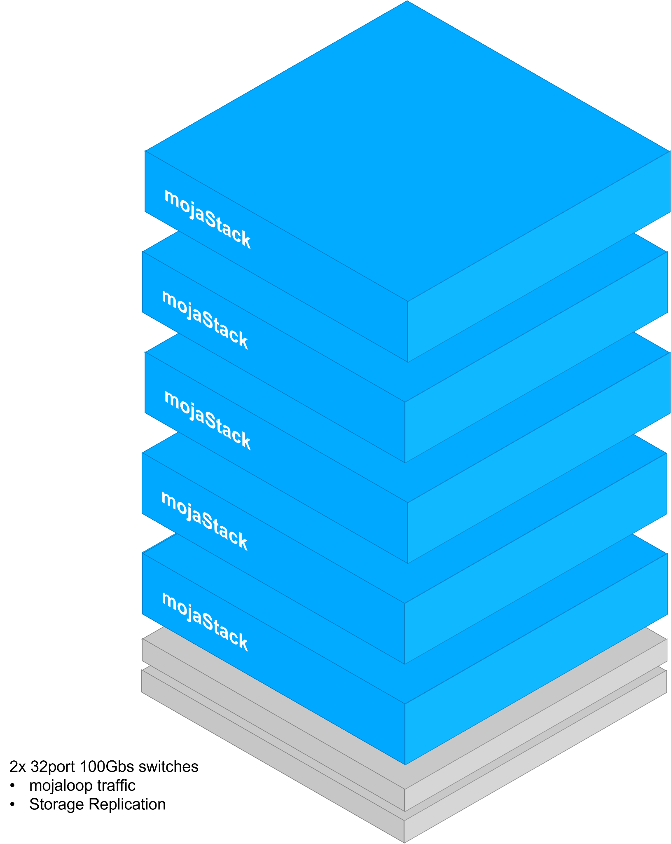
mojaStack
Meet the mojaStack cluster:
Dual 32 port 100Gbs switches support up to 14 nodes in a stack
Storage is replicated between nodes – in the event of a failure, workloads move to nearest copy of data.
2x100Gbs storage networking ensures sufficient replication bandwidth
2x100Gbs mojaloop networking for failover and minimal latency
ALL services run within the stack – no additional hardware is required (note: mass archival storage is not included)
Open-Source software means no vendor lock-in
Centralised management (Rook, Kubernetes)
Commodity Hardware – vendor agnostic
Cattle - Not Pets!
But what about failures?

Slide 13
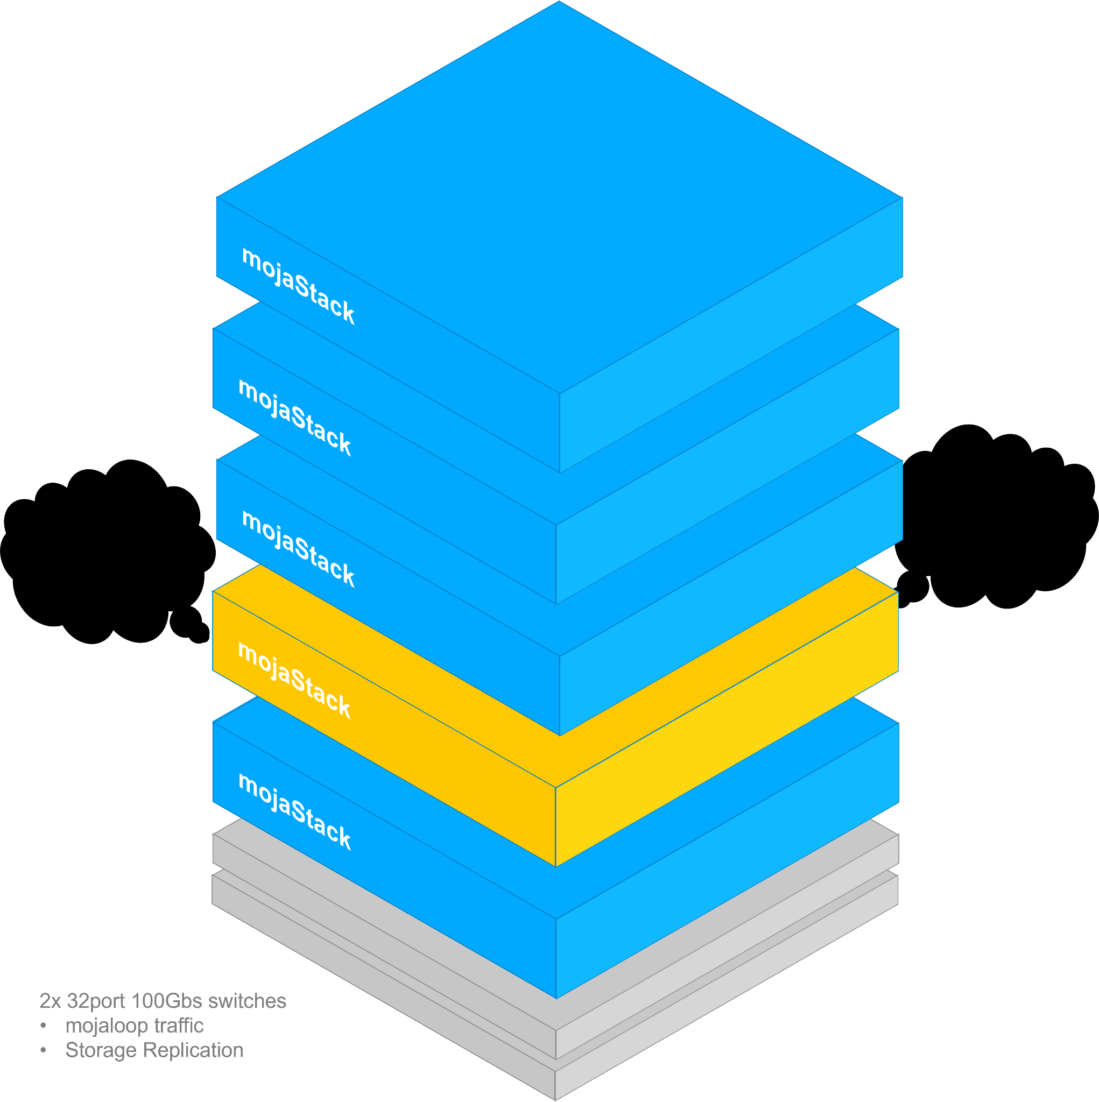
mojaStack
But what about failures?
In the event of a component failure
Node will announce it is degraded.
Storage will be mastered on other nodes.
Workloads will be re-hosted adjacent to storage.
In the event of a node failure
Node will disappear.
Active workloads will fail.
Active transactions will fail.
Storage will mastered on other nodes.
Workloads will be restarted adjacent to storage.

Slide 14
Understanding Scale - Approach
STEP 1:
Validate baseline workload assumptions
Principles:
Use baremetal cloud services against a variety of patterns to validate workload characteristic hypothesis.
Identify optimal price-performance configurations
Ignore availability concerns

Slide 15





Understanding Scale - Approach
Software stack will consist of:
 | microK8S-ha | This kubernetes distro supports easy adding/removal of nodes and HA configurations.
 | MetalLB | Load-balancer implementation designed for bare-metal deployment.
 | CoreDNS suite | CoreDNS plugins such as k8s-external/k8s-gateway.
 | Ceph | Ceph storage is super-fast, extremely resilient and highly configurable as block, file or object.
 | Rook | Rook configures Ceph using the operator model.

Slide 16
Understanding Scale - Approach
STEP 2:
Define a pattern of transactions that constitutes a ‘typical’ workload
Principles:
Transaction-traffic based on “busy” periods - PayDay, National Holiday etc.
Generation of workload is to be outside the cluster-under-test.
Limitations in specific software or hardware components may be accommodated for by scaling software horizontally.

Slide 17
Understanding Scale - Approach
I/O
Understand the limits of
MySQL, Kafka, MongoDB, etc
Security
Determine overheads (i.e. encryption)
Scalability
Compare patterns:
Horizontal Scale-out
Vertical Scale-out
Synchronous Replication
Asynchronous Replication
Configurations
Optimize config for scalability
Kafka Partitions / Replication Factors, compression, encryption etc
Finding the limits
I/O
Identify bottlenecks:
Storage - Logs, Audits
Networking - Ingress/Egress - Proxies, Gateways, etc
Security
Determine overheads
mTLS
Scalability
Network Latency Impact
Replication Latency Impact
Infrastructure
Persistence
Simulators Determine Simulator limits & scalability
Tooling
Generate Load and monitoring of system resources and throughputs
Application
Resources
Understand consumption
Determine Policies
Scalability
Optimize scaling of specific components
Configurations
Optimize configs for scalability (clients for Kafka, MySQL, etc)
Security
Model JWS overheads

Slide 18
Understanding Scale - Approach
STEP 3:
Define a ‘Standard’ hardware pattern for non-critical deployment
Principles:
Moderate specification aims for an achievable baseline.
Customer-centric on-premises deployments.
Vendor-agnostic, commodity hardware ensures availability to everyone.
Failure-Protection in software - not hardware.

Slide 19
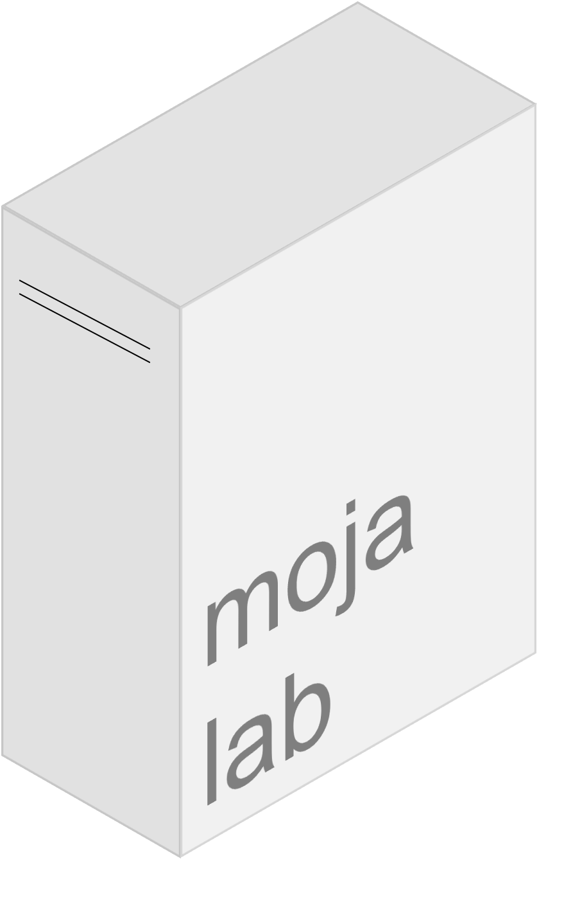
Understanding Scale - Approach
An example of an on-prem PoC
Whilst high-end, this workstation-grade computer is available globally with lead-times < 8 weeks.
There is the inclusion for an optional 25Gbs network upgrade in cases where storage replication throughput becomes a bottleneck.
A pair of 1TB NVMe SSDs can be configured to run in RAID0 to maximise storage throughput, or as separate disks to mitigate pipelining.
The use of a Ryzen CPU ensures adequate PCIe bandwidth is provided to each device, whilst ensuring sufficient cores are available for both storage and compute duties.
CPU | AMD Ryzen 5965WX 24 cores @ 4.5Ghz
RAM | 4 x 32GB 3200MHz
DISK | 1TB NVMe M.2 SSD
DISK | 1TB NVMe M.2 SSD
NIC | Dual 10Gbs SFP+
NIC (option) | Dual 25Gbs SFP28
PSU | 1000w
Unit Cost ~$4000

Slide 20
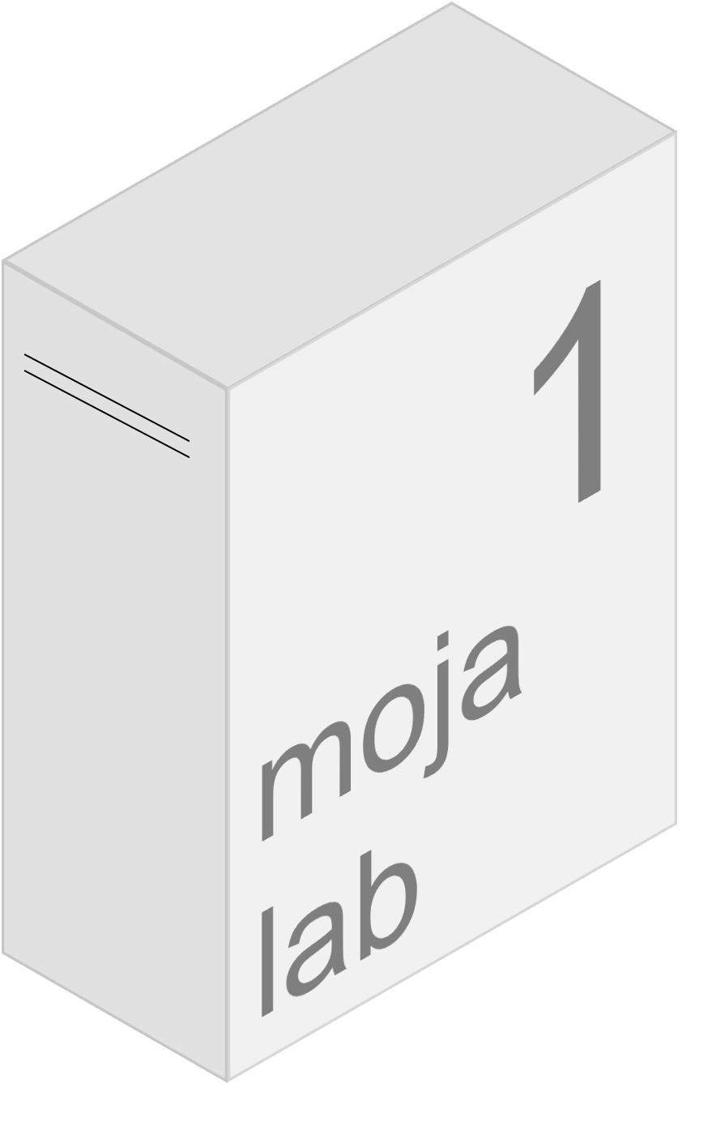


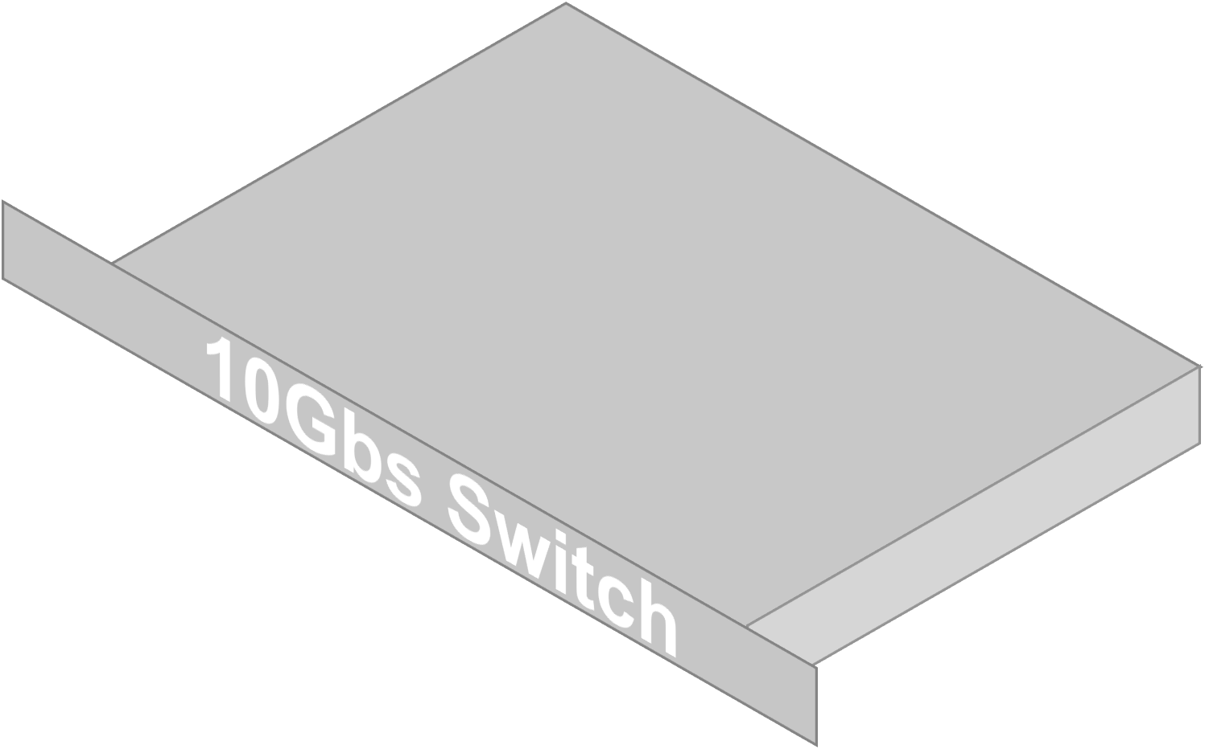
Understanding Scale - Approach
For modelling customer workloads on-prem, three lab-scale nodes are connected with dual 10Gbs connections (optional 25Gbs) to the 10/25 Gbs switch. Storage replication connections are configured to a dedicated VLAN. Application traffic is configured to another. 1Gbs or 10Gbs uplinks from the switch can be connected to allow test-traffic to access the system in a friendly-user PoC. For performance testing, Node 3 can be configured to generate intense workloads against a replicating pair (1 & 2). Alternatively, a development team can run multiple, concurrent tests from their workstations.

Slide 21
Production Ready
Building a production solution

Slide 22
Bringing this to production
Standardized Testing
2. Customer Configuration
3. Configuration Testing
4. Procure
Today
Standardized Dataset and hardware testing in-cloud
Configure the mojaloop-IaC for your use-case
Conduct a friendly-user PoC against the proposed configuration in-cloud and on-prem hardware
Results inform purchasing BoM
Develop mojaStack-IaC
Understand which components need to scale
See where bottlenecks are going to be.
Deliver a standardized configuration to feed into customer-specific depoyments
Inputs:
How much throughput?
Traffic shape
Risk-Appetite
Result:
A baseline configuration specific to customers needs
Adjust configuration to optimize customer specific workload.
Verify scaling & availability requirements can be met.
Test results are used to build:
Infrastructure Scaling Plan
Phased Bill-of-Materials
Scale-out Business Case

Slide 23
Q & A
Thank You for listening

Slide 24
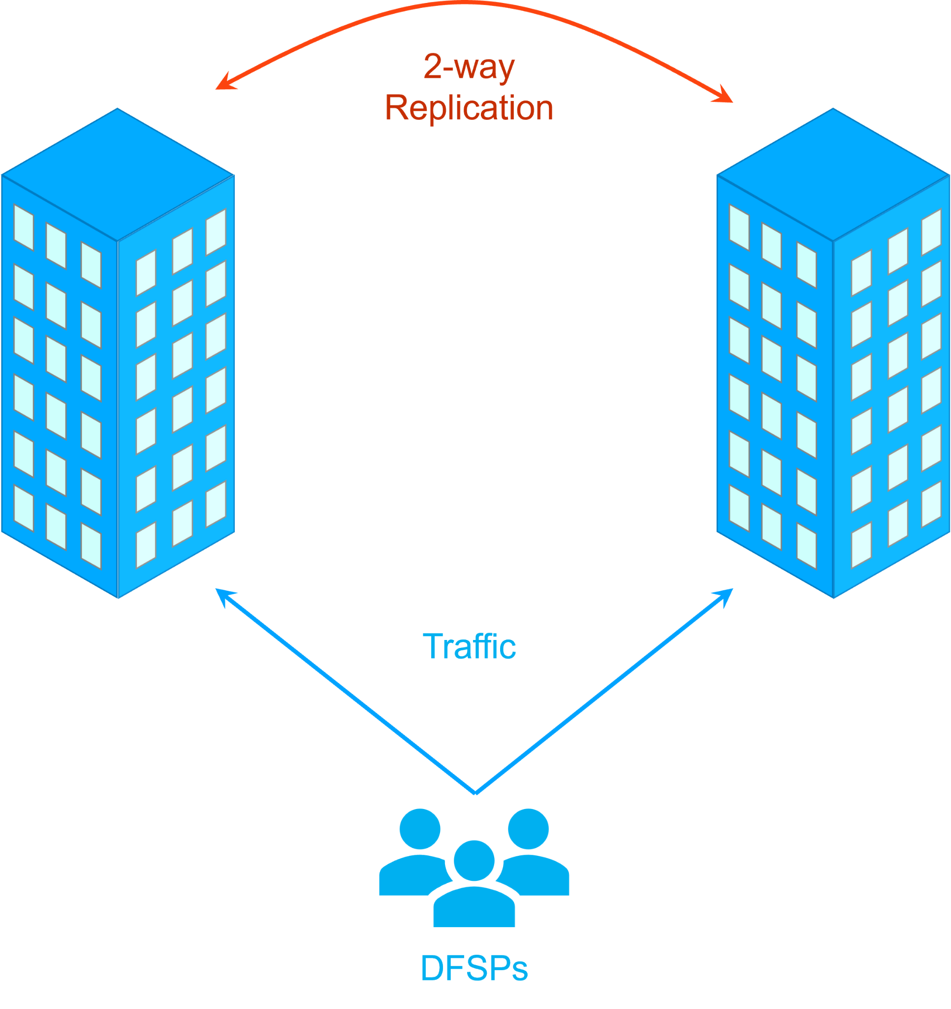
Understanding Availability
Is N+1 enough: Active + Active
Under Normal Operation
Every transaction must wait for replication (issues in one DC may still affect the other).
Maintenance requires pausing replication and incoming traffic to target DC.
50% of each DC must be reserved for peak transaction flow.
Failover must be tested often.
During a controlled failover
No interruption to transaction traffic – DC ‘drains’ inbound connections.
In-Flight transactions will finish.
Best performed during periods of low-throughput.
During an uncontrolled failover
In-Flight transactions to failed DC will be lost.
In-Flight transactions to healthy DC will pause.
Likely to require Manual Failover.
Significant Risk of ‘Active-Active Split-Brain’.

Slide 25
Understanding Availability
1+0 = 1
I am NOT leader
Is N+1 enough: Active + Active + Active?
1+0 = 1
I am NOT leader
1+1 = 2
I AM leader!
During a network partition:
All 3DCs can see 1 other DC.
1DC can see 2DCs.
Replication between all 3 DCs continues.
Any DC with one connection will respect the mastering decision of its partner DC, which will have two connections.
Performance need not be impacted.

Slide 26
Understanding Scale - Methodology
Characterization of the System and its Scalability will need to be addressed by the following pillars:
Infrastructure ← Understand the underlying Infrastructure limits
I/O ← Understand the general Input-Output limits of Storage (i.e. Logs), and Networking (i.e. Ingress/Egress - Proxies, Gateways, etc) limits in isolation
Security ← Determine overheads (i.e. TLS)
Scalability ← Understand the impact of scaling Infrastructure (i.e. Network latencies)
what other factors can we add here?
Persistence Stores ← Understand the Persistent limits
I/O ← Understand the limits of our Persistent Stores (i.e. MySQL, Kafka, MongoDB, etc) in isolation
Scalability ← Determine the best scaling approach (i.e. master-master vs master-slave, horizontal vs vertical, etc) and their impact
Configurations ← Determine the required configurations to support scalability (i.e. Kafka Partitions / Replications Factors, compression, encryption etc)
Security ← Determine overheads (i.e. encryption)
what other factors can we add here?
Application ← This is needed to ensure that we can scale predictably and in a stable fashion
Resources ← Understanding resource usage, and determining how to set Resource Policies.
Scalability ← Determine which parts of the system are scalable, and their scalability approach (i.e. horizontal vs vertical, scaling policies)
Configurations ← Determine Application configurations to support the scalability (i.e. MySQL, Kafka client configurations - message compression, etc)
Security ← Determine overheads (i.e. JWS)
Simulators ← Determine Simulator limits & scalability
what other factors can we add here?
Notes:
Here is how we test @Bryan & @ Miguel – need your input here how do we test in a way that identifies “hotspots” in our deployments (DFSP simulator generated workloads, for example) Take a couple of slides :o)
Notes:
- This is my initial brain dump on this. Perhaps we can diagrami’ify this information to be more easily accessible, or even make a seperate slide for each of the main points ~ Miguel

